Slide 1
UPPER SIXTH ARTS
GEOGRAPHY
Lesson 10
Globalisation
Notes:
Good morning, class, and welcome to our geography lesson. I am your geography teacher, Mr Kamdem. Today we are starting Lesson 10: Globalisation.

Slide 2
CLASS INFO
Class, Chapter and Duration
Class | Upper Sixth Arts
Chapter | Module 7: Understanding and managing contemporary environmental and development issues
Duration | 2 periods (2 × 50 minutes)
Notes:
This lesson is for Upper Sixth Arts. It belongs to Module 7: Understanding and managing contemporary environmental and development issues. We shall need 2 periods to cover it.

Slide 3
IDENTIFICATION
Lesson Identification
Topic | Current Development Issues
Sub-topic | Globalisation
Lesson | Lesson 10: Globalisation
Notions / Concepts | Globalisation, transnational corporation (TNC), containerisation, ICT, shrinking world.
Syllabus focus | Meaning; components; evidence; factors (TNCs, shipping and containerisation, air transport, ICT); positive and negative impacts.
Competence | Learners are able to explain globalisation, its factors and impacts.
Notes:
Our topic is Current Development Issues, and the sub-topic is Globalisation. The key notions we shall use today are: globalisation, transnational corporation (TNC), containerisation, ICT, shrinking world. At the end, you should be able to do this: learners are able to explain globalisation, its factors and impacts.

Slide 4

HOMEWORK CORRECTION
Correction of the Homework
Question (Lesson 9: New Industrial Strategy for Development):
Compare South Korea and Cameroon in 1960 and today using two indicators.
Notes:
Before we start the new lesson, let us correct the homework I gave you at the end of Lesson 9: New Industrial Strategy for Development. The question was: Compare South Korea and Cameroon in 1960 and today using two indicators. Take out your exercise books.

Slide 5
HOMEWORK CORRECTION
Correction: Possible Answer
Example: in 1960 both were poor farming countries with GNI per person below 200 US$. Today South Korea has over 30,000 US$ and exports cars and electronics, while Cameroon has about 1,600 US$ and exports raw materials.
Notes:
Here is a good answer. Example: in 1960 both were poor farming countries with GNI per person below 200 US$. Today South Korea has over 30,000 US$ and exports cars and electronics, while Cameroon has about 1,600 US$ and exports raw materials. Compare it with your own answer and correct your work in red.

Slide 6
LESSON PLAN
Lesson Plan
Correction of the homework
Objectives and recall
Real-life situation and action to take
Learning activities
Board summary
Evaluation, remediation and homework
Notes:
Here is the plan of our lesson today. First, we shall correct the homework. Then we shall look at the objectives and recall what you already know. After that, we shall study a situation from real life and the action to take, and do the learning activities. Finally, we shall copy the board summary, do the evaluation and the remediation, and I will give you the homework.

Slide 7
OBJECTIVES
Objectives
By the end of this lesson, you should be able to:
Define globalisation and its components.
Explain the factors of globalisation.
Evaluate its positive and negative impacts.
Notes:
By the end of this lesson, you should be able to do three things. Number 1: define globalisation and its components. Number 2: explain the factors of globalisation. Number 3: evaluate its positive and negative impacts.

Slide 8
PREVIOUS KNOWLEDGE
Previous Knowledge
Many goods in our markets come from abroad.
Phones connect people across the world.
Notes:
Let us first remember what you already know. Many goods in our markets come from abroad. Phones connect people across the world. Keep this in mind, because we shall build on it today.

Slide 9
REAL-LIFE SITUATION
Situation in Real Life
A student in Garoua wears clothes made in China, uses a phone designed in the USA and watches European football. Her uncle grows cotton that is sold to Asia.
Notes:
Listen carefully to this situation from real life. A student in Garoua wears clothes made in China, uses a phone designed in the USA and watches European football. Her uncle grows cotton that is sold to Asia. Think about it, because I am going to ask you some questions.

Slide 10
REAL-LIFE SITUATION
Situation: Question 1
What is the problem in the situation?
Notes:
Question 1: What is the problem in the situation? Think for a moment, then raise your hand to answer.

Slide 11
REAL-LIFE SITUATION
Answer
Our lives are linked to the whole world.
Notes:
Good. Our lives are linked to the whole world.

Slide 12
REAL-LIFE SITUATION
Situation: Question 2
What is this process called?
Notes:
Question 2: What is this process called? Think for a moment, then raise your hand to answer.

Slide 13
REAL-LIFE SITUATION
Answer
Globalisation.
Notes:
Good. Globalisation.

Slide 14
REAL-LIFE SITUATION
Situation: Question 3
Give one thing that makes it possible.
Notes:
Question 3: Give one thing that makes it possible. Think for a moment, then raise your hand to answer.

Slide 15
REAL-LIFE SITUATION
Possible Answer
Phones and internet (or ships and planes).
Notes:
Good. Phones and internet (or ships and planes).

Slide 16
ACTION TO TAKE
Action to Take
Use globalisation to learn and trade while protecting local culture and products.
Notes:
From this situation, the action we are working towards in this lesson is the following: use globalisation to learn and trade while protecting local culture and products.

Slide 17
JUSTIFICATION
Justification of the Lesson
This lesson helps us to understand how the world is becoming one system.
Notes:
Why is this lesson important for you? This lesson helps us to understand how the world is becoming one system.

Slide 18
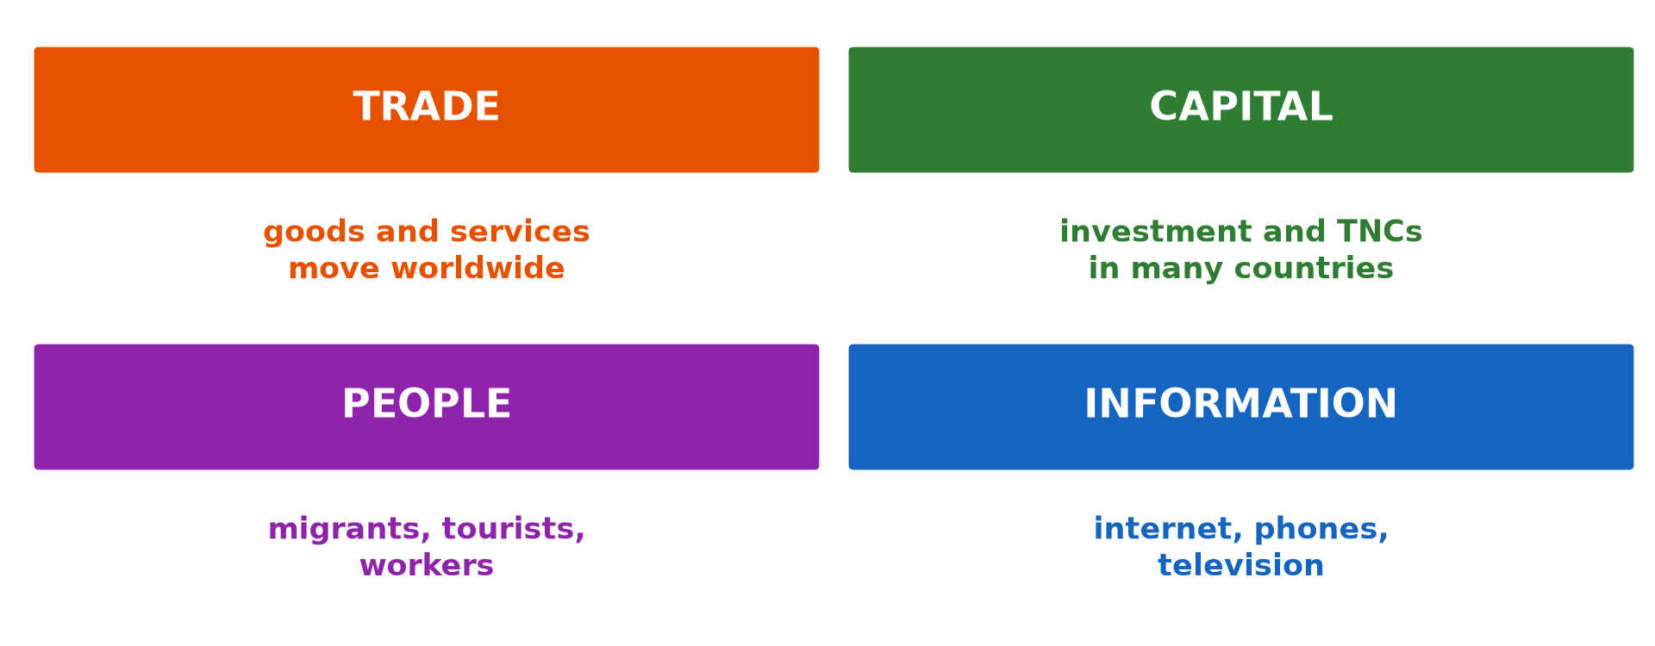
1. MEANING AND COMPONENTS
Activity 1
Components of globalisation.
Notes:
Activity 1. Look carefully at this diagram: components of globalisation. Observe every detail before I ask the question.

Slide 19
1. MEANING AND COMPONENTS
Activity 1: Question
Name the four components of globalisation.
Notes:
Here is the question for Activity 1: Name the four components of globalisation. Take one minute to think and write your answer in your rough notebook.

Slide 20
1. MEANING AND COMPONENTS
Activity 1: Answer
Trade, capital, people and information.
Notes:
Let us check the answer together. Trade, capital, people and information.

Slide 21

2. FACTORS: TNCs
Activity 2
Containers carrying goods worldwide.
Notes:
Activity 2. Look carefully at this picture: containers carrying goods worldwide. Observe every detail before I ask the question.

Slide 22
2. FACTORS: TNCs
Activity 2: Question
What is a transnational corporation?
Notes:
Here is the question for Activity 2: What is a transnational corporation? Take one minute to think and write your answer in your rough notebook.

Slide 23
2. FACTORS: TNCs
Activity 2: Answer
A company that operates in many countries, like Total or Nestlé.
Notes:
Let us check the answer together. A company that operates in many countries, like Total or Nestlé.

Slide 24
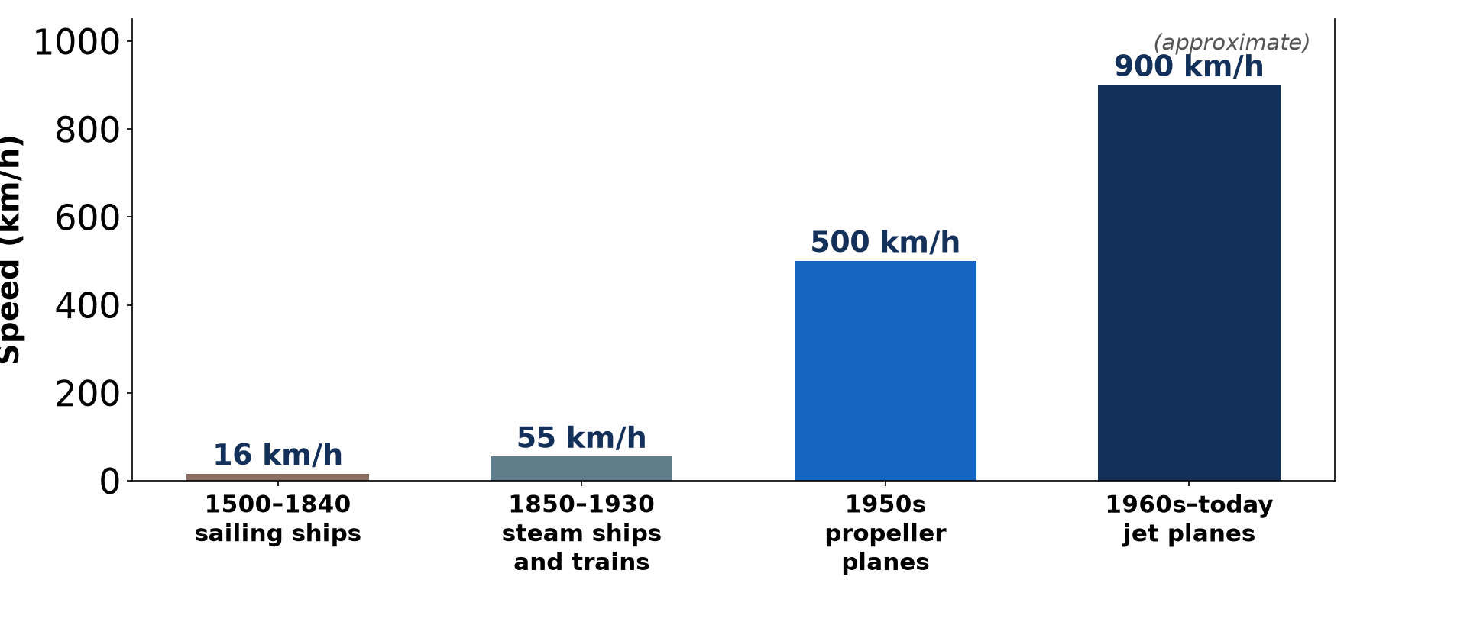
2. FACTORS: TRANSPORT
Activity 3
Faster transport (approximate).
Notes:
Activity 3. Look carefully at this diagram: faster transport (approximate). Observe every detail before I ask the question.

Slide 25
2. FACTORS: TRANSPORT
Activity 3: Question
How did transport make the world "shrink"?
Notes:
Here is the question for Activity 3: How did transport make the world "shrink"? Take one minute to think and write your answer in your rough notebook.

Slide 26
2. FACTORS: TRANSPORT
Activity 3: Answer
Faster ships and jets reduced travel time between places.
Notes:
Let us check the answer together. Faster ships and jets reduced travel time between places.

Slide 27

2. FACTORS: ICT
Activity 4
An internet café.
Notes:
Activity 4. Look carefully at this picture: an internet café. Observe every detail before I ask the question.

Slide 28
2. FACTORS: ICT
Activity 4: Question
How does ICT help globalisation?
Notes:
Here is the question for Activity 4: How does ICT help globalisation? Take one minute to think and write your answer in your rough notebook.

Slide 29
2. FACTORS: ICT
Activity 4: Answer
Internet and phones send information and money instantly everywhere.
Notes:
Let us check the answer together. Internet and phones send information and money instantly everywhere.

Slide 30
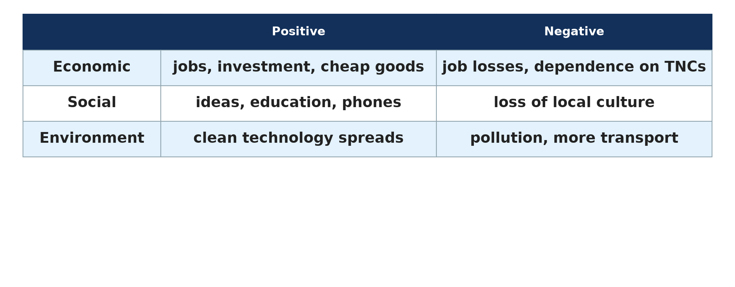
3. IMPACTS
Activity 5
Positive and negative impacts.
Notes:
Activity 5. Look carefully at this diagram: positive and negative impacts. Observe every detail before I ask the question.

Slide 31
3. IMPACTS
Activity 5: Question
Give two positive and two negative impacts of globalisation.
Notes:
Here is the question for Activity 5: Give two positive and two negative impacts of globalisation. Take one minute to think and write your answer in your rough notebook.

Slide 32
3. IMPACTS
Activity 5: Answer
Positive: jobs, cheap goods. Negative: loss of culture, dependence on TNCs.
Notes:
Let us check the answer together. Positive: jobs, cheap goods. Negative: loss of culture, dependence on TNCs.

Slide 33
BOARD SUMMARY
Board Summary
Topic: Current Development Issues
Sub-topic: Globalisation
Lesson 10: Globalisation
Notes:
Now we are going to copy the board summary. Write the title and the headings neatly in your notebooks. I will give you enough time for each slide, so do not rush.

Slide 34
BOARD SUMMARY
1. Meaning and Components
Globalisation can be defined as follows:
Globalisation: It is the growing links between countries through trade, money, people and information. The world behaves more and more like one market.
Notes:
Let us copy Meaning and Components. Globalisation can be defined as follows. On this slide we have Globalisation. Write each point on a new line, with the key term first, and explain it in your own words when we revise. When you finish, we go to the next slide.

Slide 35
BOARD SUMMARY
1. Meaning and Components (continued)
Components: Economic globalisation concerns trade and investment, and cultural globalisation concerns music, food and fashion. Political and technological globalisation also link countries.
Notes:
We continue with Meaning and Components. On this slide we have Components. Write each point on a new line, with the key term first, and explain it in your own words when we revise. When you finish, we go to the next slide.

Slide 36
BOARD SUMMARY
1. Meaning and Components (continued)
Evidence: Goods from many countries are sold everywhere and TNCs operate worldwide. The same brands, films and ideas spread across the world.
Notes:
We continue with Meaning and Components. On this slide we have Evidence. Write each point on a new line, with the key term first, and explain it in your own words when we revise.

Slide 37
BOARD SUMMARY
1. Meaning and Components
Illustration: components of globalisation
Notes:
Now draw this illustration in your notebook: components of globalisation. Give it a title and label it clearly.

Slide 38
BOARD SUMMARY
2. Factors of Globalisation
Globalisation is driven by the following factors:
TNCs: A transnational corporation has its headquarters in one country and branches in many others. Firms like Total or Nestlé move money, jobs and technology across borders.
Notes:
Let us copy Factors of Globalisation. Globalisation is driven by the following factors. On this slide we have TNCs. Write each point on a new line, with the key term first, and explain it in your own words when we revise. When you finish, we go to the next slide.

Slide 39
BOARD SUMMARY
2. Factors of Globalisation (continued)
Shipping and air transport: Containerisation and giant ships have made sea transport cheap. Jet aircraft carry people and valuable goods quickly, so the world has "shrunk".
Notes:
We continue with Factors of Globalisation. On this slide we have Shipping and air transport. Write each point on a new line, with the key term first, and explain it in your own words when we revise. When you finish, we go to the next slide.

Slide 40
BOARD SUMMARY
2. Factors of Globalisation (continued)
ICT: The internet and mobile phones share information instantly. They allow online banking, trade and communication worldwide.
Notes:
We continue with Factors of Globalisation. On this slide we have ICT. Write each point on a new line, with the key term first, and explain it in your own words when we revise.

Slide 41
BOARD SUMMARY
2. Factors of Globalisation
Illustration: faster transport has shrunk the world
Notes:
Now draw this illustration in your notebook: faster transport has shrunk the world. Give it a title and label it clearly.

Slide 42
BOARD SUMMARY
3. Impacts of Globalisation
Globalisation has the following impacts:
Positive impacts: Globalisation brings investment, jobs, cheap goods and new ideas. Poor countries can export more and receive technology.
Notes:
Let us copy Impacts of Globalisation. Globalisation has the following impacts. On this slide we have Positive impacts. Write each point on a new line, with the key term first, and explain it in your own words when we revise. When you finish, we go to the next slide.

Slide 43
BOARD SUMMARY
3. Impacts of Globalisation (continued)
Negative impacts: Local industries may die from competition and profits often go to rich countries. It can also spread diseases, pollution and loss of culture.
Notes:
We continue with Impacts of Globalisation. On this slide we have Negative impacts. Write each point on a new line, with the key term first, and explain it in your own words when we revise.

Slide 44
BOARD SUMMARY
3. Impacts of Globalisation
Illustration: positive and negative impacts
Notes:
Now draw this illustration in your notebook: positive and negative impacts. Give it a title and label it clearly.

Slide 45
FORMATIVE EVALUATION
Evaluation 1
Give three factors of globalisation.
Notes:
Now let us check what you have understood. Question 1: Give three factors of globalisation. Answer in your exercise book.

Slide 46
FORMATIVE EVALUATION
Expected Answer
TNCs, container shipping and ICT.
Notes:
The expected answer is: tNCs, container shipping and ICT. If you got it right, well done.

Slide 47
FORMATIVE EVALUATION
Evaluation 2
Give one advantage and one disadvantage of TNCs for Cameroon.
Notes:
Now let us check what you have understood. Question 2: Give one advantage and one disadvantage of TNCs for Cameroon. Answer in your exercise book.

Slide 48
FORMATIVE EVALUATION
Expected Answer
Advantage: jobs. Disadvantage: profits go abroad.
Notes:
The expected answer is: advantage: jobs. Disadvantage: profits go abroad. If you got it right, well done.

Slide 49
REMEDIATION
Remediation
Fill in the blanks:
A company in many countries is a ______.
Metal boxes for goods are ______.
Internet and phones are ______.
Notes:
For those who need more practice, fill in the blanks in your exercise book. The answers are: number 1, TNC; number 2, containers; number 3, ICT.

Slide 50
HOMEWORK
Homework
List ten objects in your home and the country where each was made.
Notes:
For your homework: List ten objects in your home and the country where each was made. We shall correct it at the beginning of our next lesson.

Slide 51
NEXT LESSON
Next Lesson
Our next lesson will be on:
Lesson 11: International Trade
Notes:
Our next lesson will be on Lesson 11: International Trade. Thank you for your attention, and see you next time.

Slide 52
BILINGUAL GAME
Bilingual Game (Jeu Bilingue)
English | Français
Globalisation | La mondialisation
Company | L'entreprise
Container | Le conteneur
Internet | Internet
Culture | La culture
Brand | La marque
Notes:
Let us play the bilingual game. I say a word in English, and you give me the French word. Then we do the reverse.

Slide 53
LOGBOOK
Official Logbook (1/2)
Module / Topic | Current Development Issues
Lesson Title | Lesson 10: Globalisation
Expected Learning Outcomes | Define globalisation and its components. Explain the factors of globalisation. Evaluate its positive and negative impacts.
Competence | Learners are able to explain globalisation, its factors and impacts.
Notes:
I record this information in the official logbook of the class after the lesson.

Slide 54
LOGBOOK
Official Logbook (2/2)
Matter Taught | Meaning and Components; Factors of Globalisation; Impacts of Globalisation.
Evaluation | Formative evaluation and remediation exercise.
Homework | List ten objects in your home and the country where each was made.
Enrolment / Present / Absent | ____ / ____ / ____
Achievement | To be completed after the lesson.
Notes:
I complete the second page of the logbook: the matter taught, the evaluation, the homework and the attendance.

Slide 55
TEACHER'S NOTE
Teacher's Note
Timing: Homework correction, plan, objectives 8 min | Recall, situation, action 10 min | 5 activities 30 min | Board summary (copying) 30 min | Evaluation, remediation 10 min | Homework, next lesson 5 min | Logbook 7 min
Without the projector (Activity 1): give an example of each.
Without the projector (Activity 2): name TNCs in Cameroon.
Without the projector (Activity 3): read the bars.
Without the projector (Activity 4): discuss phone use.
Without the projector (Activity 5): sort the impacts.
Notes:
This slide is for me, the teacher: it gives the timing of the lesson and what to do if the projector is not available.

Slide 56
REFERENCES
References
National Geography Syllabus, MINESEC/IGE/IP-SS, 2019 — Module 7 (Environment and Development).
Photo, Activity 2: “Container Ships @ Port of Oakland” by jdnx, CC BY 2.0, via Flickr (https://www.flickr.com/photos/21442511@N08/3464243881)
Photo, Activity 4: “Woman uses a computer in an internet cafe” by World Bank Photo Collection, CC BY-NC-ND 2.0, via Flickr (https://www.flickr.com/photos/10816734@N03/7556691396)
Diagrams and animations: drawn for this lesson (Geography Department).
Notes:
These are the references and picture credits used to prepare this lesson.

